Slide 1
Going Live

Slide 2
Objectives
In todays class we will…
Recap the basic topics covered to date
Talk about CSS Box Model and Positioning
Offer a conceptual introduction to CSS reset and downloadable style sheets
Work with Google Developer tools for site inspection
Utilize Github Pages for website deployment

Slide 3
Box Model

Slide 4
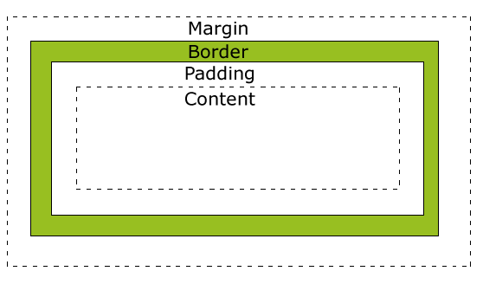
Boxes Upon Boxes
In CSS, every element rests within a series of boxes.
Each box has customizable space properties:
margin, border, and padding.
Typical spacing value: 20px 10px 10px 20px (top, right, bottom, left)

Slide 5
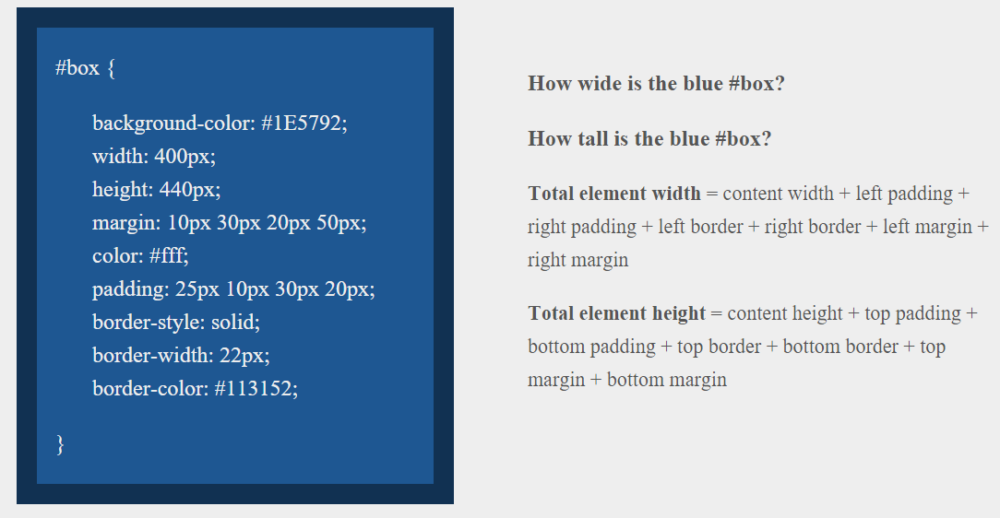
> YOUR TURN!!
Suggested Time: 10 min

Slide 6
> YOUR TURN!!
Answer
Width: 474 px (no margin), 554 px (with margin)
Height: 539 px (no margin), 569 px (with margin)

Slide 7
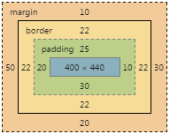
> YOUR TURN!!
Answer
Width: 474 px (no margin), 554 px (with margin)
Height: 539 px (no margin), 569 px (with margin)

Slide 8
We Be Floatin’

Slide 9
Take a Facebook Break…
Warning!
These next topics are fairly “tricky”… but VERY IMPORTANT.
Time to channel that inner genius.

Slide 10

The Concept of “Flow”
By default, every HTML element displayed in the browser is governed by a concept called flow.
This means that HTML elements force their adjacent elements to flow around them.

Slide 11
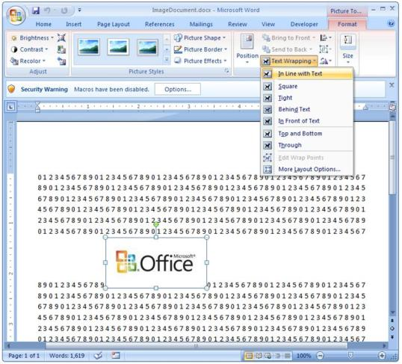
Flow Analogy to MS Word
This concept of “flow” is very similar to the wrap-text options you may be familiar with in Microsoft Word.
Just as in MS Word, you can have images in-line with text, on-top of text, etc.

Slide 12
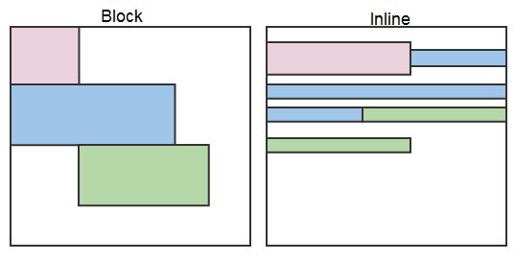
Block Elements
By default, web clients render many HTML elements as block elements. Paragraphs, headers, divs and more receive this treatment.
A block element will take up an entire line of space—unless you intervene with CSS properties.

Slide 13
Block Elements vs. Inline Elements
Now contrast the block elements with inline elements.
By using float CSS properties, we can command our website to display multiple HTML elements adjacently.

Slide 14
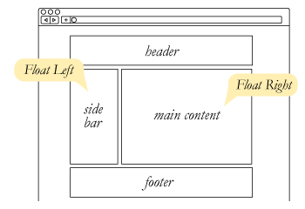
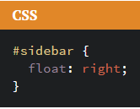
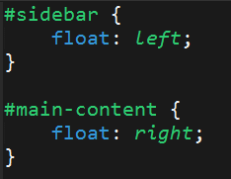
Floating
To transform these block elements into inline elements, we use a CSS property called float.
Floats are necessary for building web layouts.

Slide 15
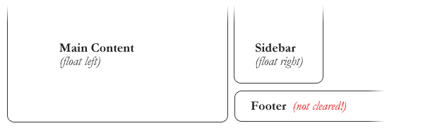
Clearing the Float
Floats often get in the way of our layouts.
Sometimes we don’t want to give each element the “inline” treatment.

Slide 16
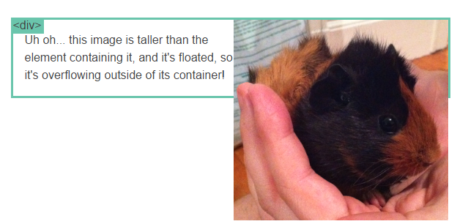
Clearfix Hack
Sometimes when elements don’t match up in size, we get situations like the above…

Slide 17
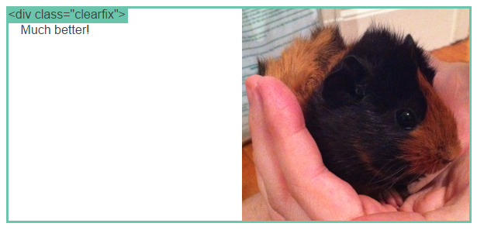
Clearfix Hack
We can get around this by using “the clearfix hack.”

Slide 18
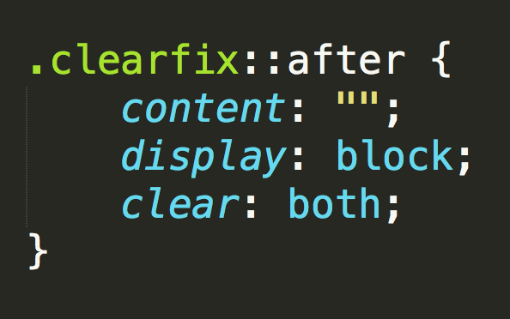
Clearfix Hack
::after is what we call a pseudo-element. We use it to style specific parts of an element.
This will add an HTML element, hidden from view, after the content of the “.clearfix” element. This clears the float.

Slide 19

Quick Demo!

Slide 20
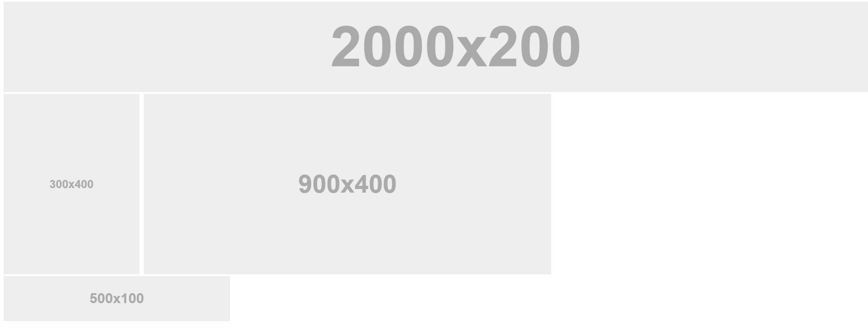
Quick Demo!

Slide 21
Quick Demo
Instructor: Demo
(2-FloatExamples)

Slide 22

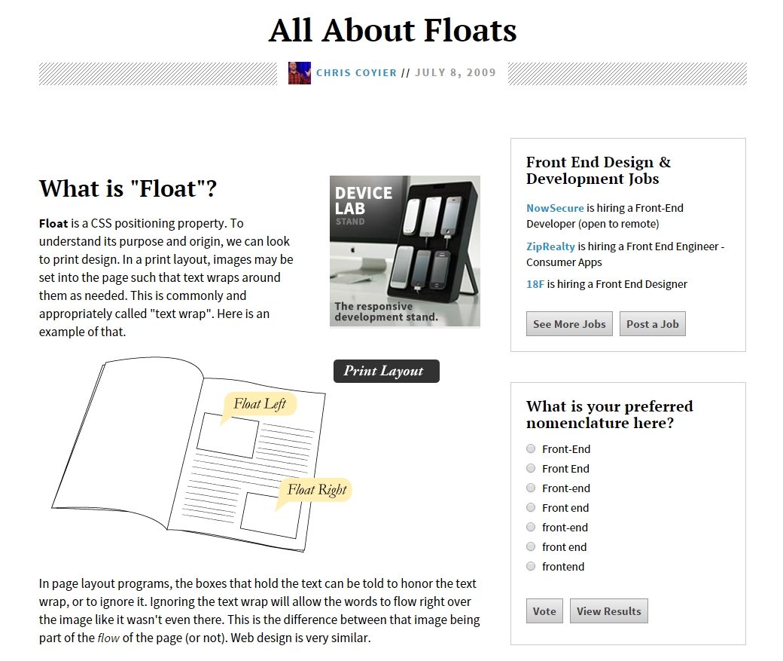
Fantastic Guide on Floats ****
To all serious front-end developers (this is a necessary read): https://css-tricks.com/all-about-floats/

Slide 23
> YOUR TURN!!
Activity: 3-FloatLayout-Activity | Suggested Time: 30 min
Assignment
In this activity, you’ll flex your newfound floating skills by creating a conceptual layout. Eyeball the design to your best ability.
Check your Slack for more instructions.

Slide 24
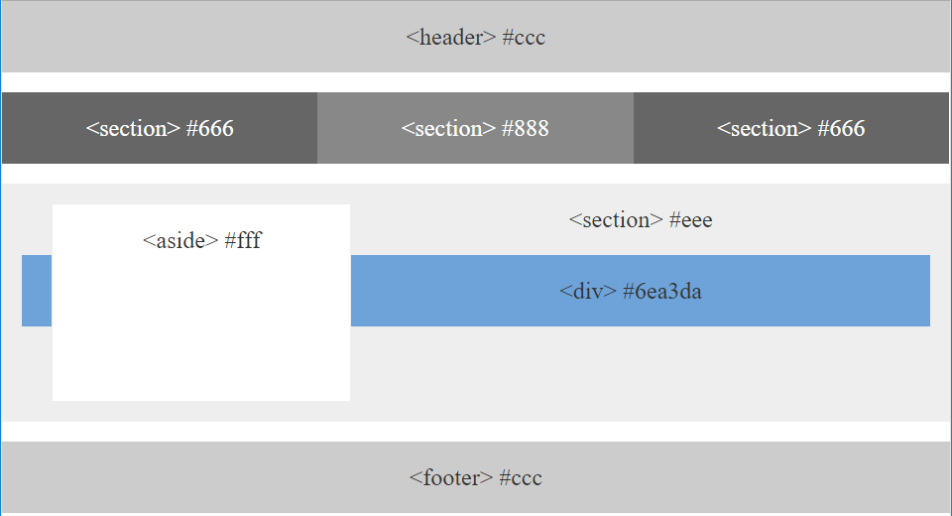
> YOUR TURN!!

Slide 25

Good work!
Your brain may rest now…

Slide 26
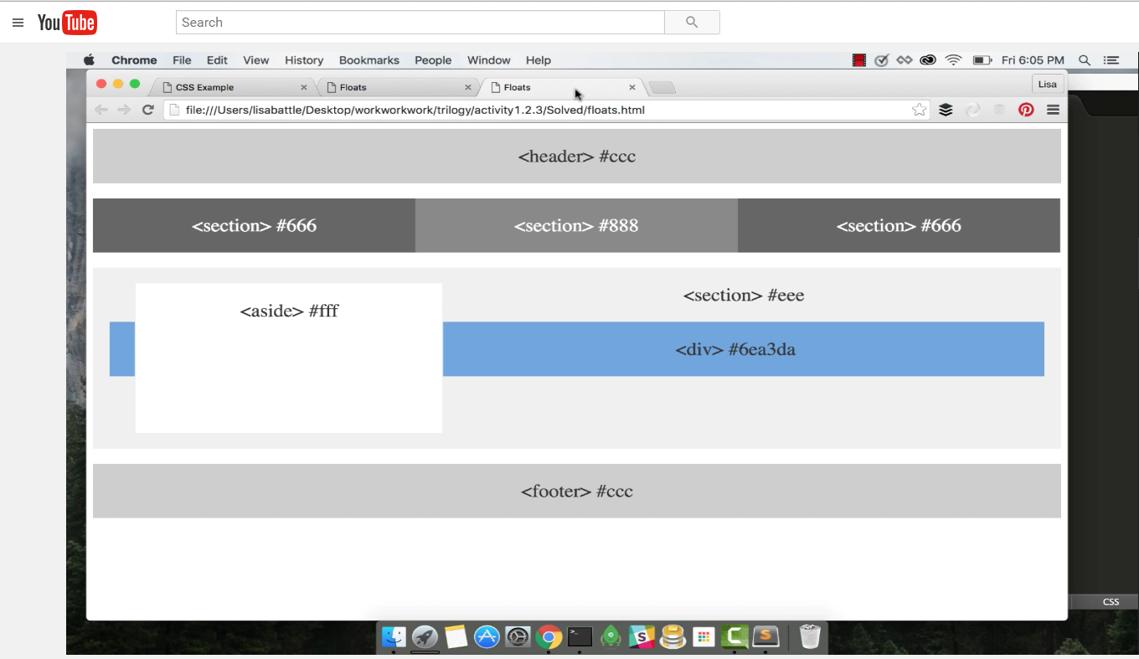
Video Walkthrough! (Highly, HIGHLY Recommend!!!)
Video Link: https://youtu.be/0lpxKw6E90Y

Slide 27
BREAK!

Slide 28
CSS Positioning

Slide 29
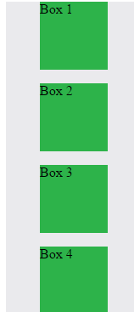
Position: Static (Default)
Four boxes placed statically (default)

Slide 30
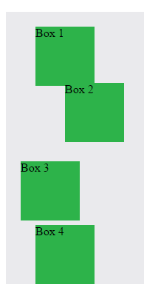

Position: Relative
Changing to position: relative will nudge the boxes in relation to their original (static) location.

Slide 31
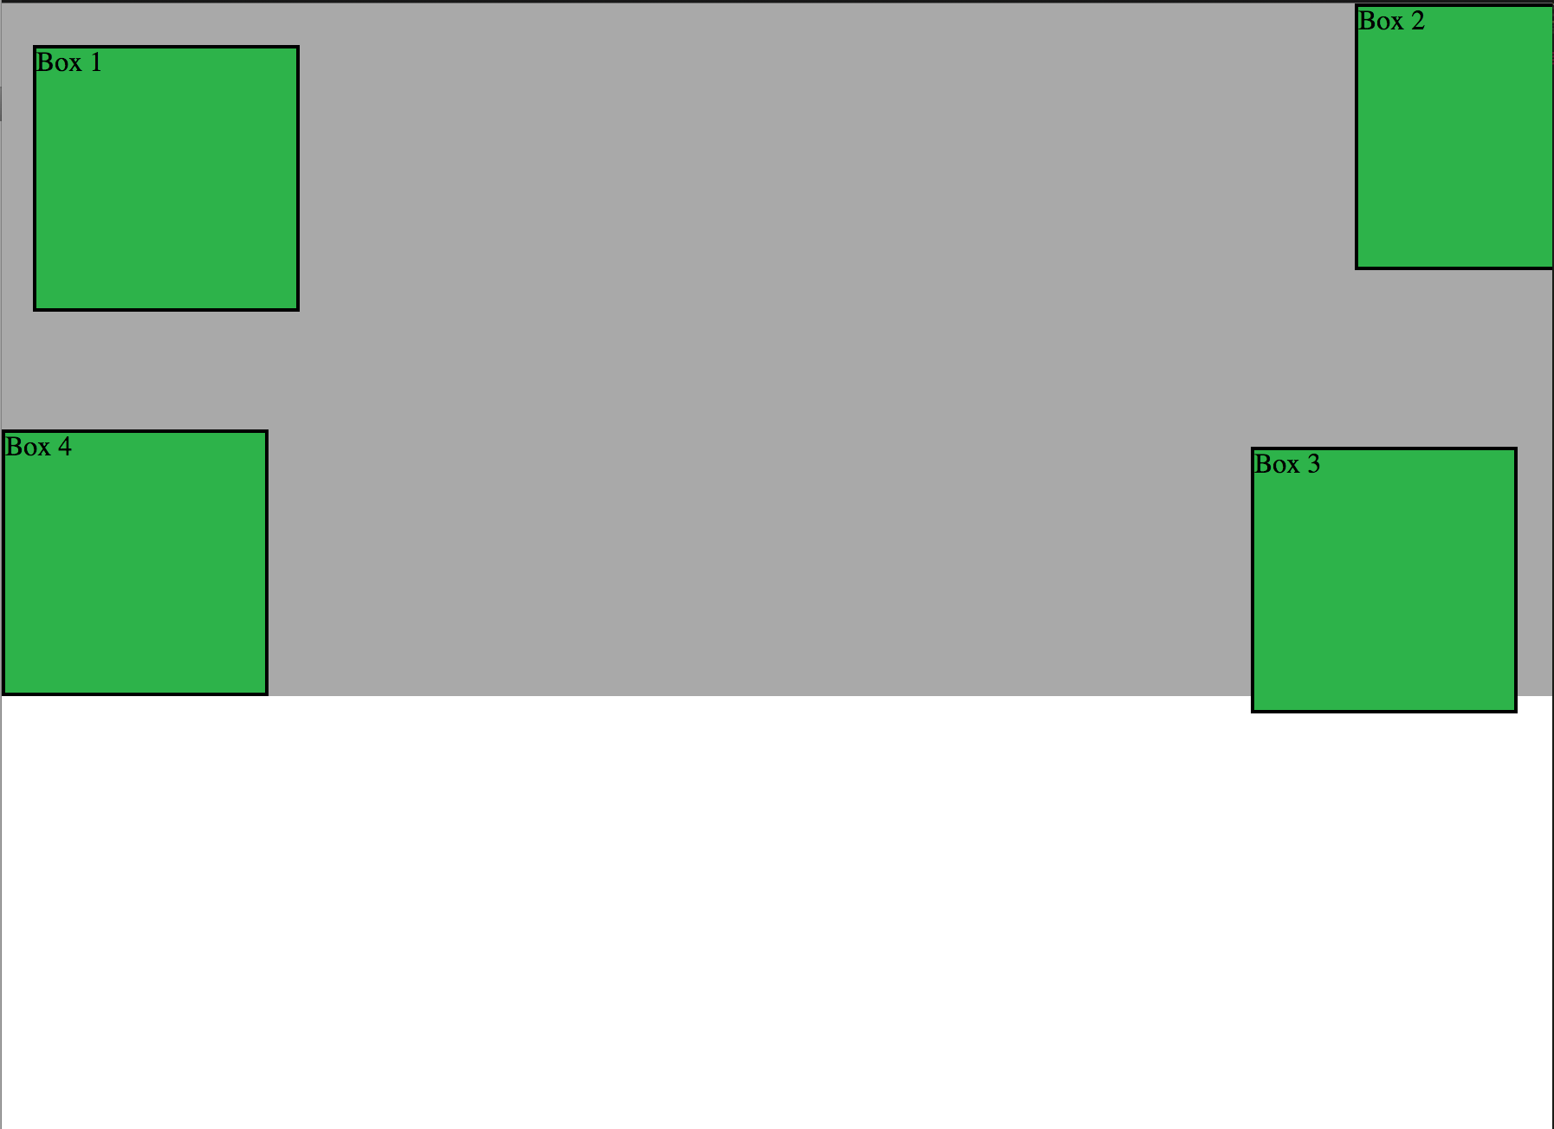
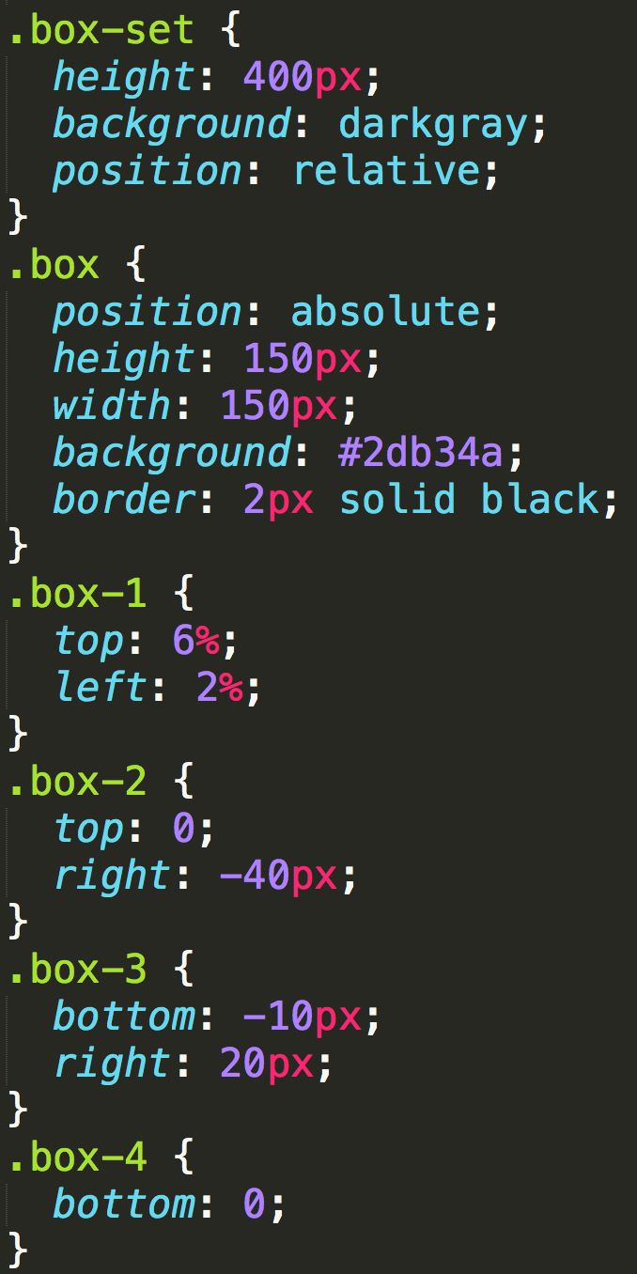
Position: Absolute
Positioned relative to nearest positioned ancestor
Notes:
An element that is positioned absolutely is taken out of the flow and thus takes up no space when placing other elements.
The absolutely positioned element is positioned relative to nearest positioned ancestor (non-static).
If a positioned ancestor doesn't exist, the initial container (body) is used.
Most complex.

Slide 32
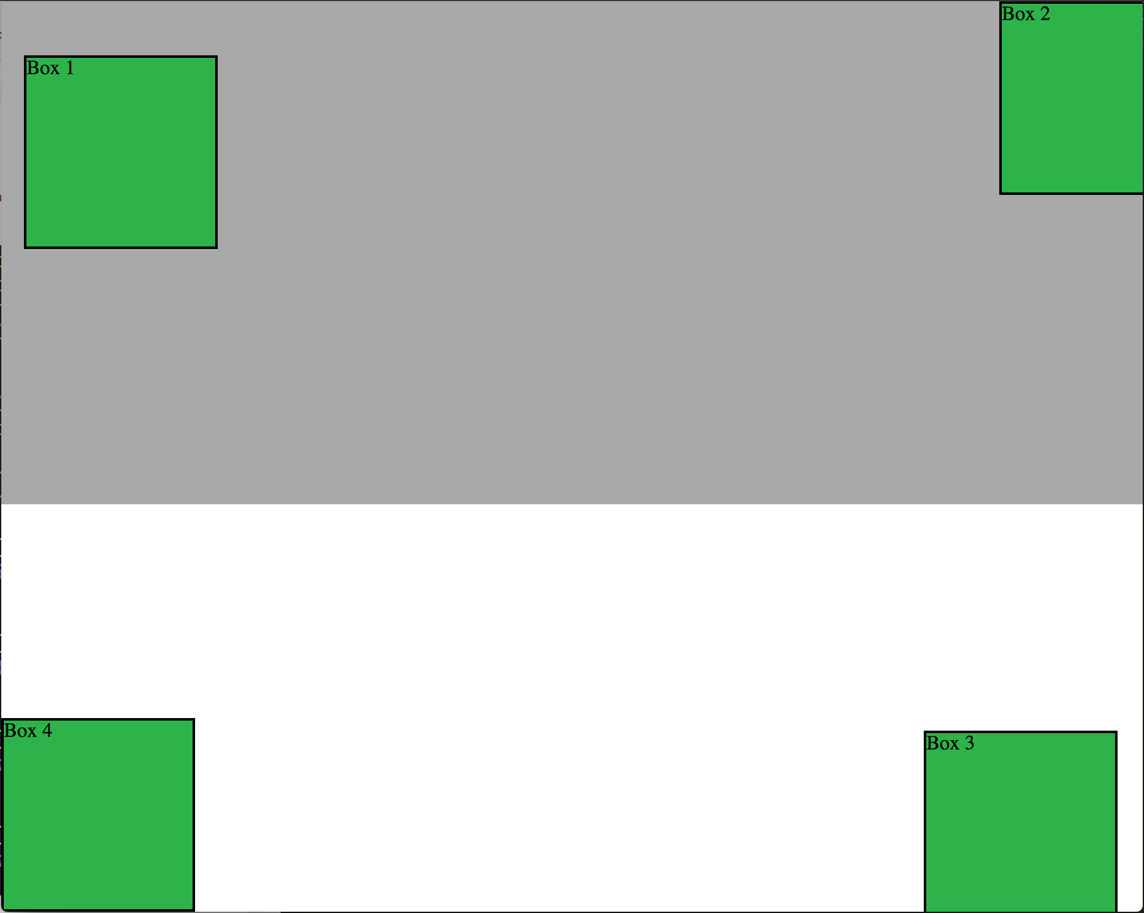
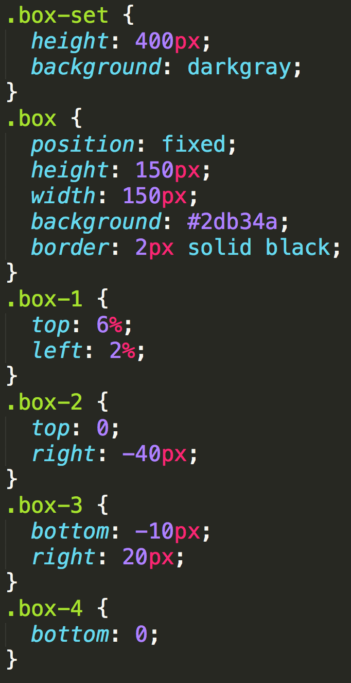
Position: Fixed
Position with exact coordinates to the browser window

Slide 33
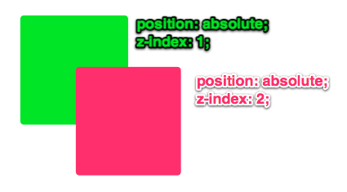
Layering with Z-Index
Z-Index allows you to layer elements on top of each other when they’re positioned.
Notes:
The elements must be positioned (any position other than static)

Slide 34
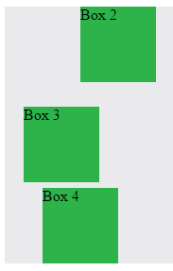
Hiding Things
“Display: none” allows us to hide elements from view.
This will become useful in later sections, when we’ll be hiding and revealing specific HTML elements of our choice.

Slide 35
Quick Demo
Instructor: Demo
(5-CSS_PositionedLayout)

Slide 36
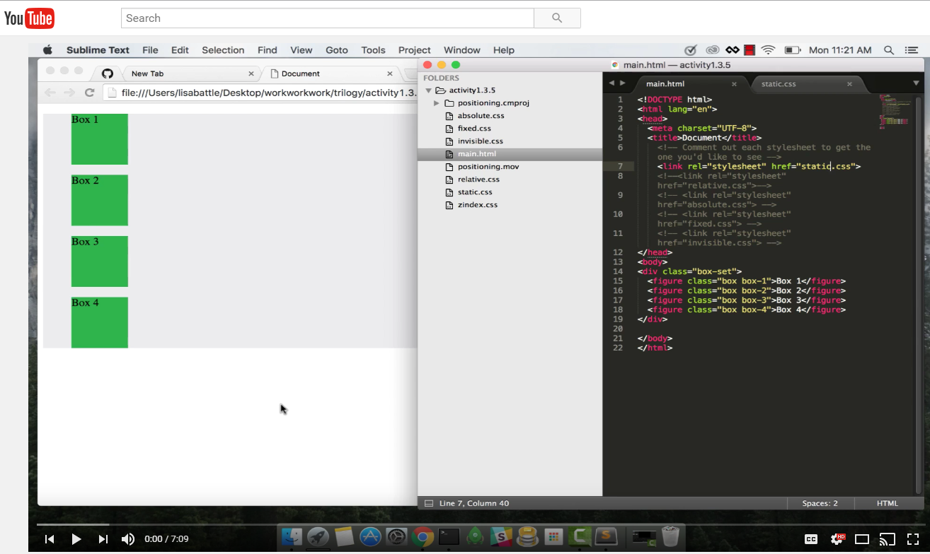
Video Walkthrough!
Video Link: https://youtu.be/sHfJn0jqBro

Slide 37
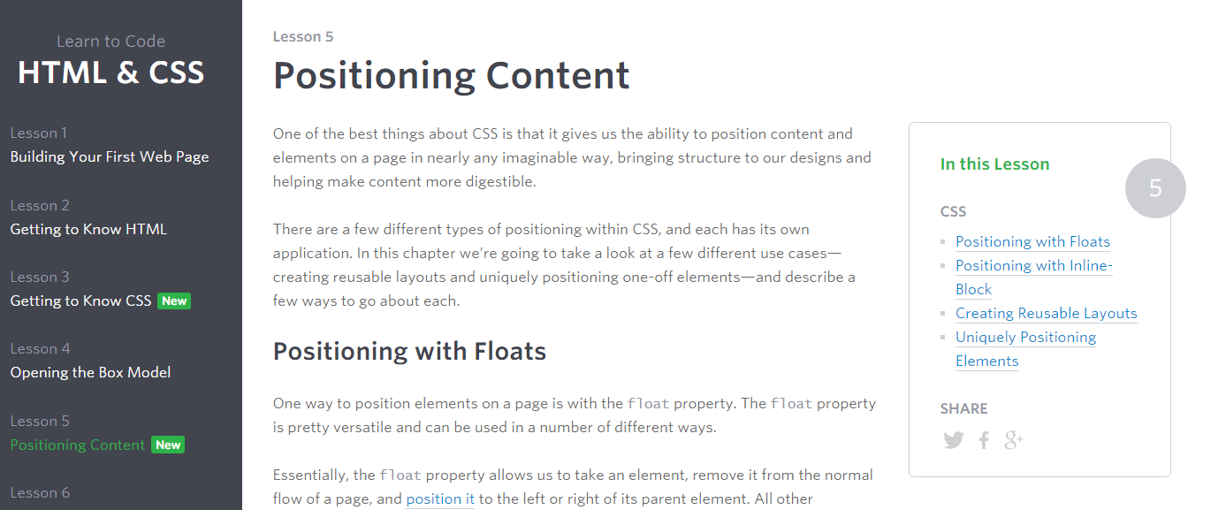
Great Resource
Another great read for front-end developers: http://learn.shayhowe.com/html-css/positioning-content/

Slide 38
> YOUR TURN!!
6-CSS_Positioned_Activity | Suggested Time: 30 min
Assignment
In this activity, you’ll flex your newfound positioning skills by creating another conceptual layout. Eyeball the design to your best ability.
Check your Slack for additional instructions.

Slide 39

> YOUR TURN!!

Slide 40
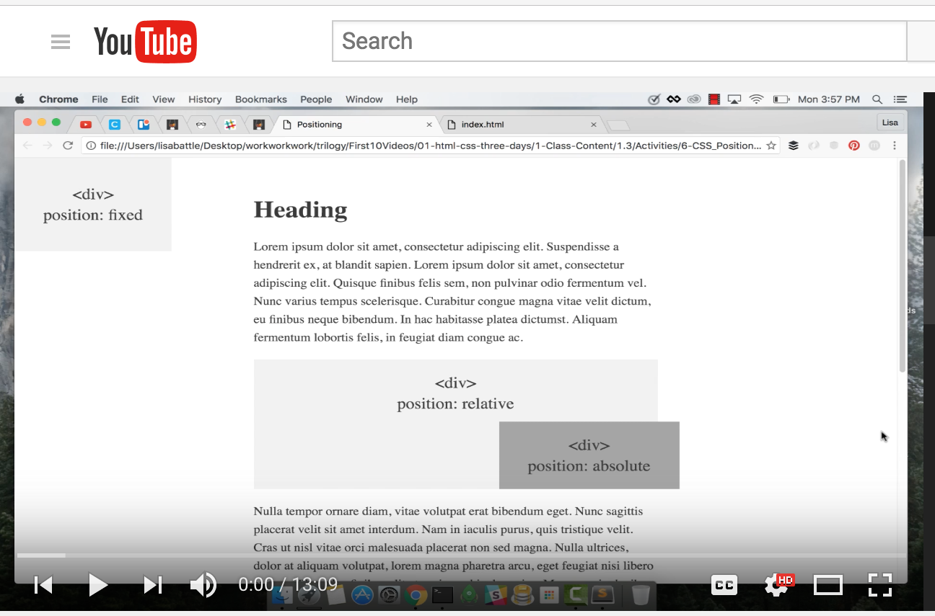
Video Walkthrough!
Video Link: https://youtu.be/yWXgnQaWSW0

Slide 41
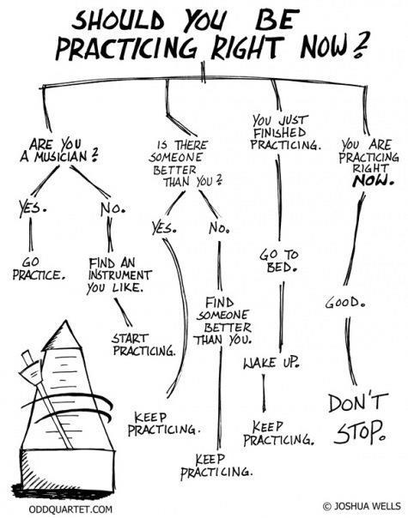
Advice
Re-do this at home. We designed this exercise
to firm up your HTML/CSS skills.
REMEMBER:
The best way to learn
web development
is to PRACTICE!

Slide 42
Chrome Inspector

Slide 43
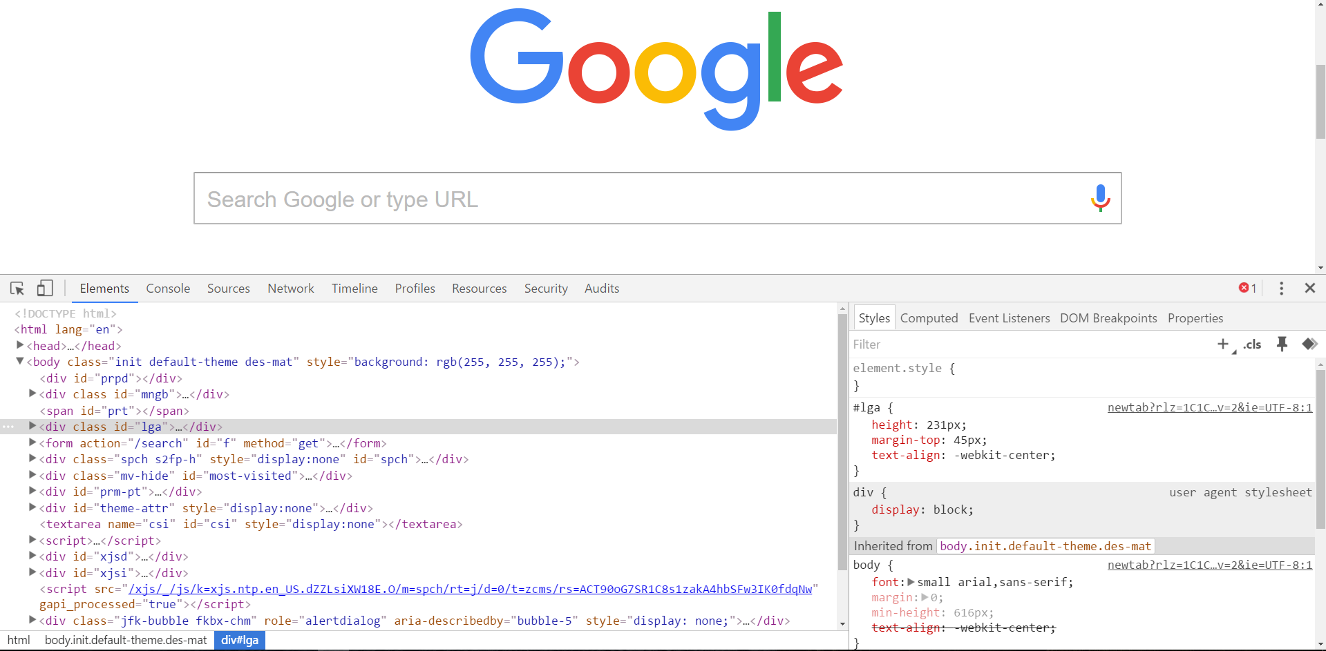
Chrome Inspector is Your Friend
To access chrome inspector, right click on a page. Then hit “Inspect.”
It will allow you to inspect the HTML, CSS and more!

Slide 44

Chrome Inspector is Your Friend
You can even edit the HTML/CSS of a webpage and instantly view your changes in the browser!
This works on any website, whether yours or not.

Slide 45
EXTRA MATERIAL

Slide 46
> YOUR TURN!!
Assignment
Take a website you commonly visit (Amazon, Google, Huff Po, etc.) and heavily modify it with Google Developer Tools.
You have 15 minutes to test Chrome Inspector. Try modifying:
Content (change words).
Colors.
Spacing.
Any other CSS style rules.
When you’re done, send a screenshot to your class’s Slack.

Slide 47
CSS Resets

Slide 48

Loading Multiple CSS Files ***(Very Important!!!)***
We can link our documents to more than one stylesheet at a time—one of the most powerful features of CSS/HTML.
By tapping into different stylesheets simultaneously, we can create complex layouts with plenty of design rules.
Just remember: the loading order matters!!!

Slide 49
What Browser?
By a show of hands…
Which browser do you use?

Slide 50

Battle of the Browsers
Under the hood, web browsers often render webpages differently than their competition.
These disparities could mean HTML/CSS displaying differently in each web client.
Because of these potential divergences, web developers need to make their websites cross-browser compatible.

Slide 51

Reset.css (or Normalize.css)
Reset.css will “reset” all browser-specific CSS. This means your site will appear the same in all browsers.
However, you will have to re-style everything yourself.

Slide 52
Why CSS Resets Matter
It’s important for creating browser-compatible websites.
It’s an example of using someone else’s CSS in your website!!!
It’s a common Front-End Developer Interview question.

Slide 53
> YOUR TURN!!
Assignment
Follow the instructions given via Slack to incorporate a reset.css file in a basic HTML file.
Note the impact of the reset file makes after you include it.

